Slide 1
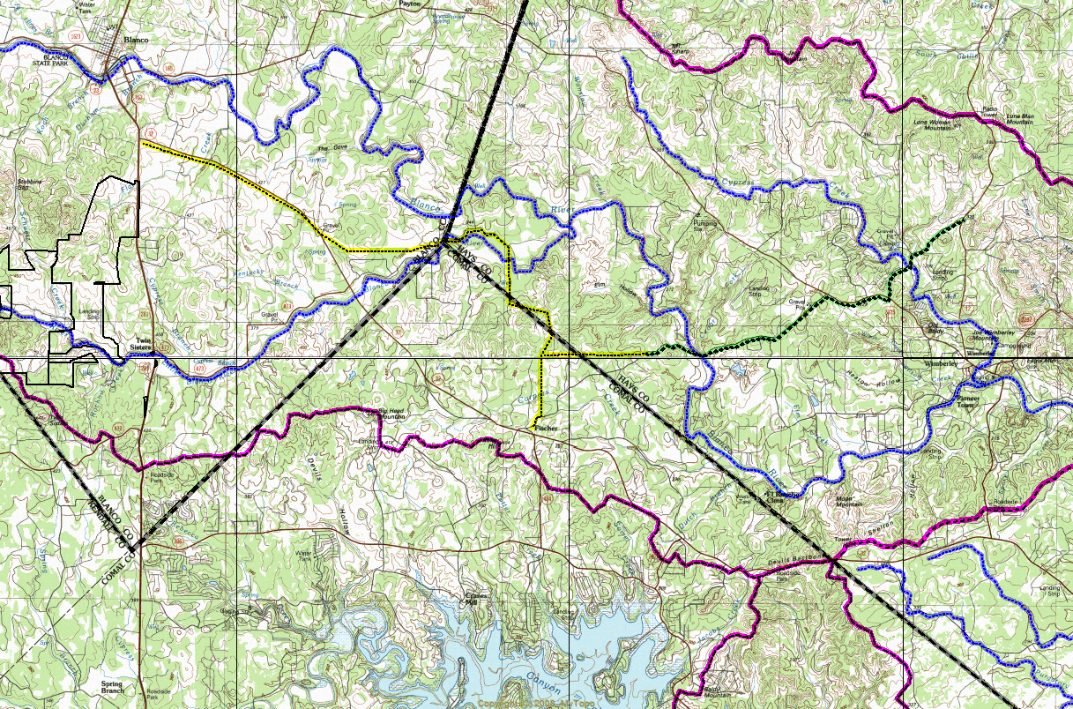
City of Blanco WTP
Texas Water Alliance (TWA) Blanco River Valley Project
Cielo Springs
(City of Blanco)
Rockin J
(Rancho del Lago)
REGION “K” - LCRA
REGION “K” - LCRA
REGION “L” - GBRA
REGION “L” - GBRA
Rust Ranch
(SJWTX)
GLENBROOK PARTNERS, LTD.
Request for TWA Wholesale Water
JACOBS WELL
Segment “B”
Segment “A”
Segment “C”
REGION “K” - LCRA
TEXAS WATER ALLIANCE (TWA) PROPOSES TO:
Supply about 1,000 af/yr of groundwater to City of Blanco and intervening landowners along 281 using existing 12” pipeline owned by City of Blanco (Segment “A”)
Construct a 14-mile pipeline to supply about 3,000 af/yr to City of Blanco and intervening landowners along 32 and provide looped water system (Segment “B”)
Work with Public Entities and Water Utilities in Hays County to supply 4,000+ af/yr of water from Canyon Lake and/or Groundwater in order to protect Jacob’s Well (Segment ”C”)
REGION “L” - GBRA
12”
12”
HH RANCH PROPERTIES, L.C.
Request for TWA Wholesale Water
16”
12”
16”
Park Shores WTP
(SJWTX)

Slide 2
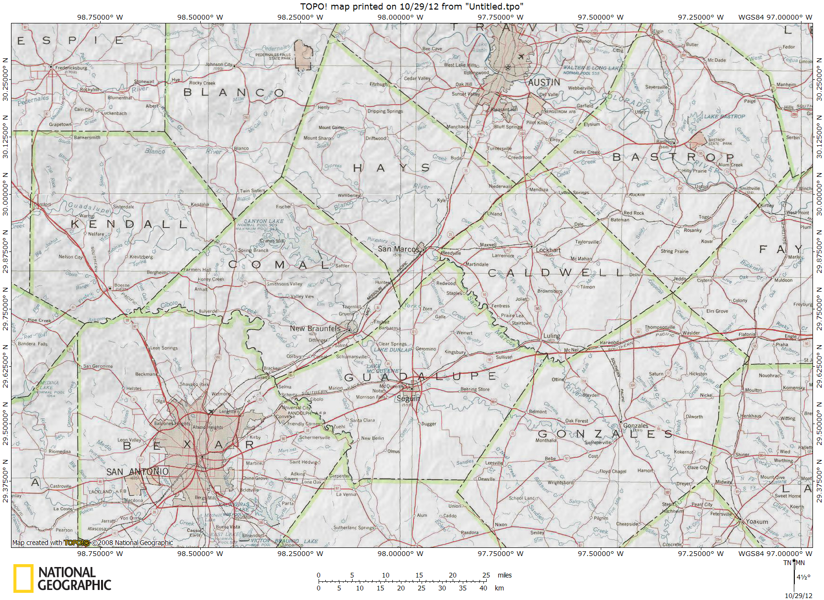
Water Sources - TWA Blanco River Valley WMS
Pending Export Permits from Carrizo Aquifer
to be Issued by Gonzales County GCD
TWA Blanco River Valley
Water Management Strategy
Buda
Kyle
HCPUA – 10,300 af/yr
San
Marcos
TWA – 15,000 af/yr
Carrizo Well Fields
TWA & HCPUA
SSLGC
CRWA
Carrizo Well Fields
CRWA,SSLGC,SAWS

Slide 3
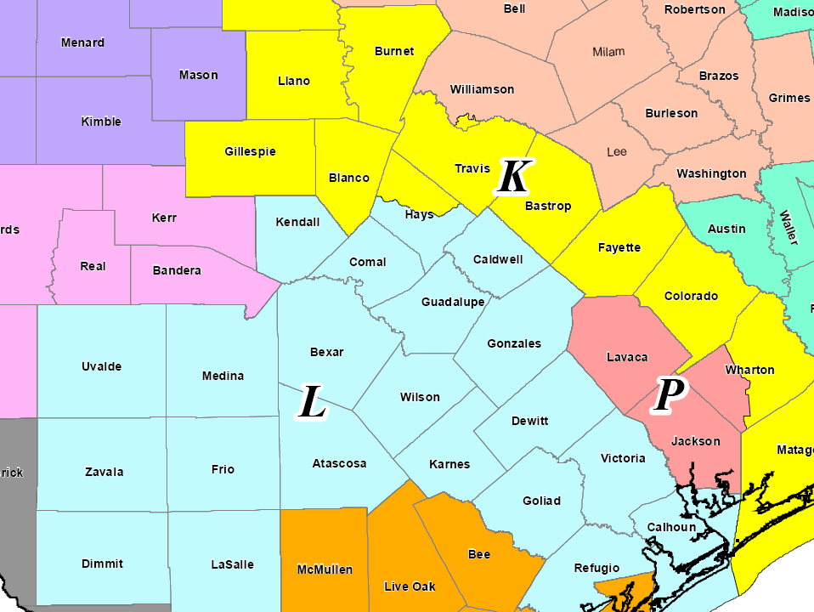
REGIONAL WATER MANAGEMENT PLANNING AREAS

Slide 4
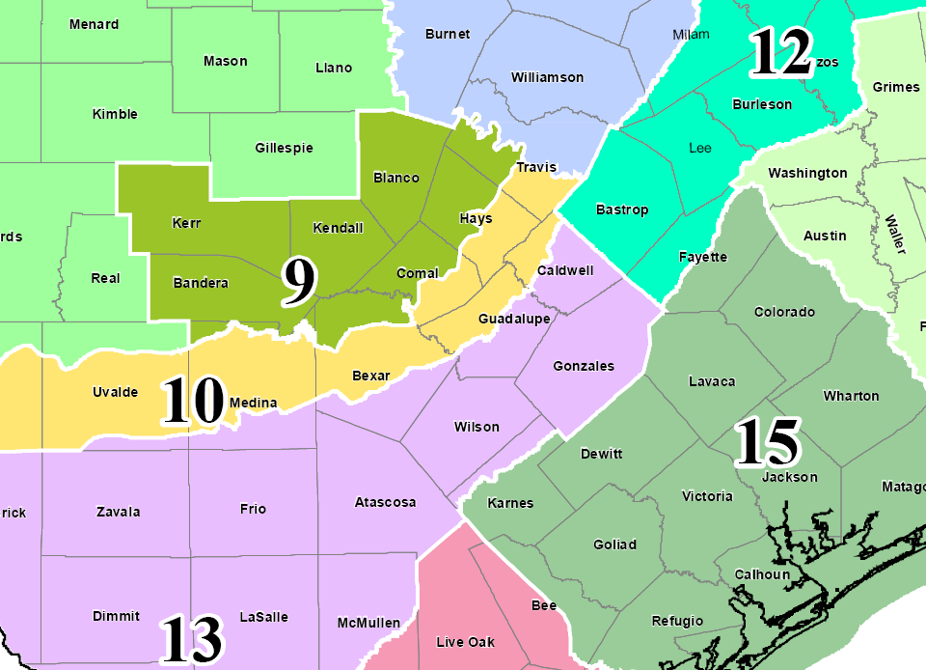
GROUNDWATER MANAGEMENT AREAS

Slide 5
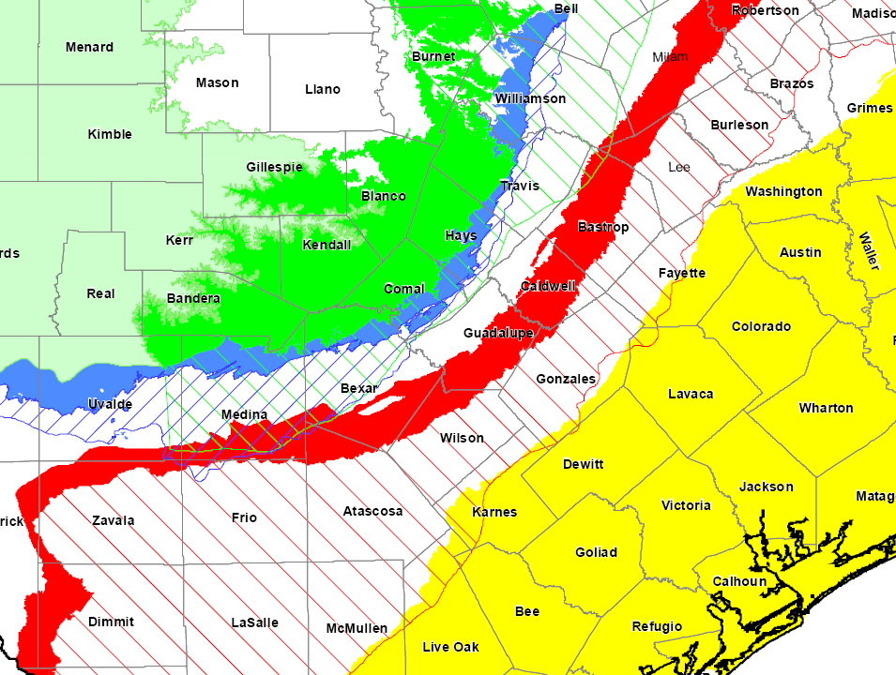
MAJOR AQUIFERS

Slide 6
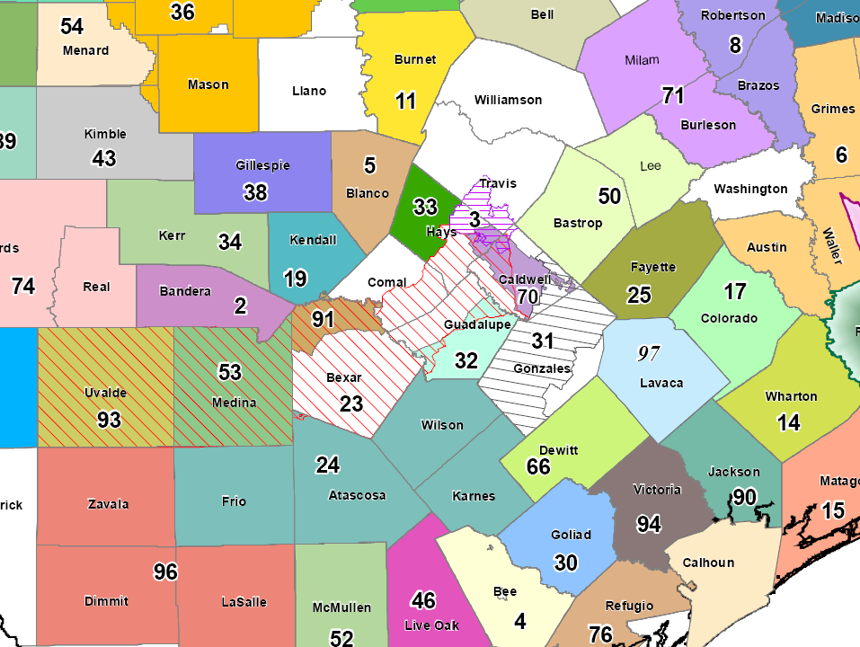
GROUNDWATER CONSERVATION DISTRICTS
Comal County Does Not have a GCD

